Slide 1

















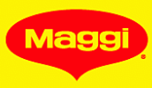



Nestlé
Company Overview
Business description
Key financials
Founded in 1866 and headquartered in Vevey, Switzerland, Nestlé is a leading global food and beverage company
  c.328,000 employees in over 150 countries
  418 factories in 86 countries
  Over 2,000 brands
  Sales presence in 91 countries; c.1bn products sold per day
  Listed on the Swiss Stock Exchange with market cap of c.CHF260bn (Jul’17)
Key product categories and brands:
  Powdered and Liquid Beverages:
  Milk products and Ice cream:
  Water:
  PetCare:
  Confectionery:
  Nutrition and Health Science:
  Prepared dishes and Cooking aids:
1
CHFm, Dec YE | 2014A | 2015A | 2016A
Revenues | 91,865 | 89,083 | 89,786
% Growth |  | (3.0%) | 0.8%
Gross Profit | 44,312 | 44,353 | 45,587
% Margin | 48.2% | 49.8% | 50.8%
EBITDA | 13,963 | 15,586 | 16,295
% Margin | 15.2% | 17.5% | 18.1%
EBIT | 10,905 | 12,408 | 13,163
% Margin | 11.9% | 13.9% | 14.7%
Net Profit | 14,456 | 9,066 | 8,531
% Margin | 15.7% | 10.2% | 9.5%
Net Debt | 12,325 | 15,425 | 13,913
Net Debt / EBITDA (x) | 0.9x | 1.0x | 0.9x
Ownership structure
Revenue breakdown 2016
Source: Public information

Slide 2








Nestlé
Strong Leadership and Experienced Management Team
Paul Bulcke
Chairman, Nestlé since 2017
Previously:
  CEO, Nestlé (2008-2016)
  Head of Nestlé Americas (2004-2008)
  Works in Nestlé Group since 1979
Nationality: Swiss / Belgian
Mark Schneider
CEO, Nestlé since 2017
Previously:
  CEO, Fresenius Group, Germany (2003-2016)
  CFO, Fresenius Medical Care, Germany (2001-2003)
Nationality: US / German
François-Xavier Roger
CFO, Nestlé since 2015
Previously:
  CFO, Takeda Pharma, Japan (2013-2015)
  CFO, Millicom, Luxembourg (2008-2013)
Nationality: French
Laurent Freixe
CEO, Nestlé Americas since 2014
Previously:
  Director, Nestlé Europe (2008-2014)
  Market Head, Nestlé Iberia (2007-2008)
  Market Head, Nestlé Hungary (2003-2007)
Nationality: French
Chris Johnson
Head of Nestlé Business Excellence since 2014
Previously:
  Head of Nestlé Americas (2011-2014)
  Market Head, Nestlé Japan (2007-2011)
Nationality: US
Wan Ling Martello
CEO, Nestlé Asia, Oceania and sub-Saharan Africa since 2015
Previously:
  CFO, Nestlé (2012-2015)
  Executive VP, Walmart Stores (2005-2011)
Nationality: US
Marco Settembri
CEO, Nestlé Europe, Middle East and North Africa since 2017
Previously:
  Head of Nestlé Waters (2013-2017)
  CEO, Nestlé Purina PetCare Europe (2007-2013)
Nationality: Italian
Patrice Bula
Head of Marketing and Sales, Nestlé since 2011
Previously:
  Market Head, Nestlé Greater China (2007-2011)
  Market Head, Nestlé Germany (2003-2007)
Nationality: Swiss
Source: Public information

Slide 3
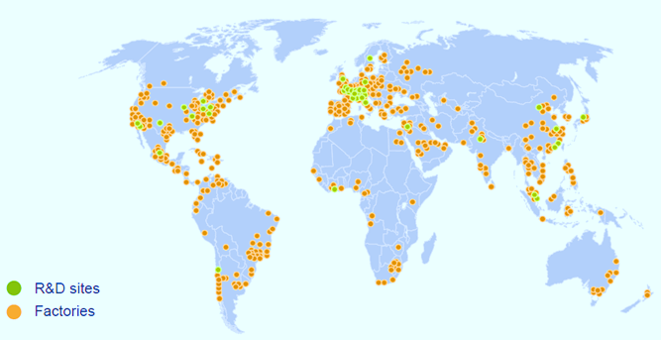
Nestlé
Unmatched Geographical Presence
Geography | Sales (CHFbn) | Trading operating profit (CHFbn) | Trading operating profit margin (%) | Employees | Factories
Europe, Middle East & North Africa | 26.4 | 5.0 | 19.0% | c.109,000 | 151
Asia, Oceania and sub-Saharan Africa | 16.2 | 2.7 | 16.7% | c.110,000 | 109
Americas | 14.5 | 2.8 | 19.3% | c.109,000 | 158
Source: Public information

Slide 4

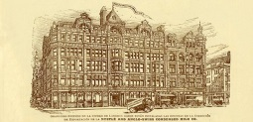
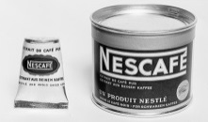
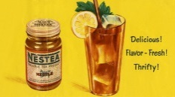
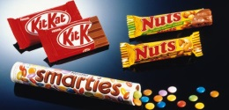
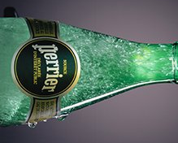
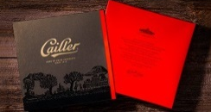

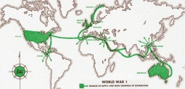


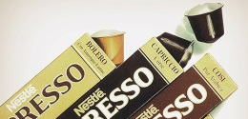
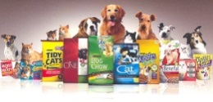
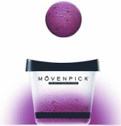
Nestlé
Long and Rich History of Innovation and Market Leadership
Pioneer years
1860s-1900s
Continued innovation
1920s-1970s
Diversified growth
1980s-2000s
Consolidation
2000s-now
1866: Anglo-Swiss Condensed Milk Company established by US brothers Charles and George Page
  Europe’s first production facility for condensed milk
1867: Farine Lactée Henri Nestlé, founded by Henri Nestlé who developed a breakthrough infant formula
1904: Nestlé begins selling chocolate for the first time
1905: The two companies merge in Nestlé & Anglo-Swiss Milk Company
1929: Peter-Cailler-Kohler (Switzerland’s largest chocolate company) is acquired
1934: Milo (malted chocolate drink) is launched
1938: Nescafe is launched
1947: Nestlé & Anglo Swiss merges with Swiss company Alimentana (Maggi soups)
1948: Nestea and Nesquik are launched
1960: Nestlé enters the ice-cream market with the acquisitions of Jopa (Germany) and Heudebert-Gervais (France)
1962: Findus frozen food brand is acquired
1969: Nestlé enters mineral water by buying a stake in Vittel
1977: Alcon Laboratories (US pharma and ophthalmic products manufacturer) is acquired for US$280m
1985: Nestlé enters pet food by acquiring Friskies
1986: Nespresso is launched
1988: Nestlé buys UK confectionery company Rowntree Mackintosh, adding brands KitKat, After Eight and Smarties to its portfolio
1988: Italian pasta, sauce and confectionery group Buitoni-Perugina is acquired
1991: Joint Venture with Coca Cola to produce and market brands including Nestea
1992: Nestlé develops its position in mineral waters by acquiring Perrier Group (France)
1998: Italian mineral waters business Sanpellegrino Group is acquired
2001: Nestlé buys US pet food business Ralston Purina, and merges it with Nestlé Friskies Petcare to establish the new market leader in pet care, Nestlé Purina Petcare
2002: Nestlé acquires the licensing rights to premium ice-cream producer Häagen-Dazs in the US and Canada
2002: IPO of Alcon on NYSE, Nestlé sells a 23% stake for US$2.2bn
2003: Mövenpick and Dreyer’s Grand Ice Cream are acquired
2007: Novartis Medical Nutrition is acquired
2010: Remaining 52% stake in Alcon sold to Novartis for US$28bn
2011: Nestlé Health Science is established
2012: Nestlé acquires Wyeth Nutrition, formerly Pfizer Nutrition, for US$12bn, to strengthen its position in infant nutrition
2015: Nestlé launches Cailler, as its first super-premium chocolate brand
Source: Public information

Slide 5
Nestlé
Share Price Performance – L3Y
CHF
Vol (m)
As of Jul’17:
Market cap: c.CHF260bn
EV: c.CHF275m
P/E: 30x
EV/EBITDA: 17x
27 Jun’16:
The Board of Nestlé announced its succession plans for the Chairman and CEO:
  Paul Bulcke, who served as CEO from 2008 to 2016, was proposed for new Chairman replacing Peter Brabeck-Letmathe who had reached the mandatory retirement age
  Mark Schneider was appointed as the new CEO starting on 1 Jan’17
26 Jun’17:
Activist investor Dan Loeb with his hedge fund Third Point, having amassed a 1.3% stake in Nestlé worth US$3.5bn, encouraged the company to sell its stake in L’Oreal, increase leverage for share buybacks and adopt a formal profitability target, among other suggestions
Nestlé’s shares rose c.5% on the news, the biggest intraday advance since Jan’15
1
1
1
1
1
Source: Public information
Notes:
1) Rebased to Nestlé’s share price

Slide 6
Nestlé
Key Financials – Overview, Discussion & Analysis
CHFm, Dec YE |  | 2014A | 2015A | 2016A
P&L
Sales |  | 91,612 | 88,785 | 89,469
 | % Growth |  | (3.1%) | 0.8%
Other Revenues |  | 253 | 298 | 317
Revenues (total) |  | 91,865 | 89,083 | 89,786
 | % Growth |  | (3.0%) | 0.8%
Cost of Goods Sold |  | (47,553) | (44,730) | (44,199)
Gross Profit |  | 44,312 | 44,353 | 45,587
 | % Margin | 48.2% | 49.8% | 50.8%
Distribution expenses |  | (8,217) | (7,899) | (8,059)
 | % Revenues | (8.9%) | (8.9%) | (9.0%)
Marketing and administration costs |  | (19,651) | (20,744) | (21,485)
 | % Revenues | (21.4%) | (23.3%) | (23.9%)
Research and development costs |  | (1,628) | (1,678) | (1,736)
 | % Revenues | (1.8%) | (1.9%) | (1.9%)
Other trading opex (net) |  | (797) | (650) | (614)
 | % Revenues | (0.9%) | (0.7%) | (0.7%)
Trading Operating Profit |  | 14,019 | 13,382 | 13,693
 | % Margin | 15.3% | 15.0% | 15.3%
Other opex (net) |  | (3,114) | (974) | (530)
 | % Revenues | (3.4%) | (1.1%) | (0.6%)
Operating Profit (EBIT) |  | 10,905 | 12,408 | 13,163
 | % Margin | 11.9% | 13.9% | 14.7%
Net Profit |  | 14,456 | 9,066 | 8,531
 | % Margin | 15.7% | 10.2% | 9.5%
Cash Flow - key items
Depreciation and Amortisation |  | 3,058 | 3,178 | 3,132
 | % Revenues | 3.3% | 3.6% | 3.5%
Capital expenditure |  | (356) | (93) | (327)
 | % Revenues | (0.4%) | (0.1%) | (0.4%)
Decrease / (increase) in net working capital |  | 10,905 | 12,408 | 13,163
 | % Revenues | 11.9% | 13.9% | 14.7%
Revenue evolution 2015 – 2016:
  In 2016, Sales increased by 0.8% to CHF89.5bn, with a foreign exchange impact of (1.6%)
  Acquisitions net of divestitures reduced sales by 0.8%
  Organic growth (sales growth adjusted for M&A, price and FX movements) was 3.2%, with real internal growth (volumes only) reaching a three-year high of 2.4%
  Price growth was limited to 0.8%, with some improvement in 2H 2016 and management expects it to improve further in 2017
  Innovation supported volume growth, with 30% of sales coming from products introduced or renovated in the last 3 years
  E-commerce accounted for 5% of sales, up 18% year-on-year
  Other Revenues are primarily third party license fees
Operating Profit evolution 2015 – 2016:
  Trading Operating Profit 2016 was CHF13.7bn with a margin of 15.3%, up 20 basis points on a reported basis and up 30 basis points in constant FX
  Nestlé achieved this margin improvement while increasing investment in brand support, digital marketing, Research and Development, and in the new nutrition and health platforms
  Consumer-facing marketing spend increased by 6.3% in constant currency
  Restructuring costs doubled to CHF300m in 2016 to support structural cost-saving initiatives
  Other trading operating expenses (opex) include restructuring costs, impairment of assets and proceeds from disposal of assets
  Other opex includes impairment of goodwill and M&A related items
Net Profit evolution 2015 – 2016:
  Net Profit of CHF8.5bn was impacted by several items, the largest one being a one-off non-cash adjustment to deferred taxes
Cash Flow evolution 2015 – 2016:
  Average net working capital decreased by 190 basis points from 4.7% to 2.8% of sales (average of last five quarters), thus improving operating cash flow
Outlook for 2017:
  In 2017, management expects organic growth between 2% and 4%
  In order to drive future profitability, management plans to increase restructuring costs considerably
  As a result, the trading operating profit margin in constant currency is expected to be stable
1
1
2
2
2
3
3
4
4
Source: Public information

Slide 7
Nestlé
Sales evolution 2014 – 2016
Sales evolution by reporting segment (CHFbn)
Nestlé is organized into three geographic zones and several globally managed businesses (GMB)
  EMENA: Europe, Middle East and North Africa
  AMS: Americas
  AOA: Asia, Oceania and sub-Saharan Africa
  GMB: Nestlé Waters, Nestlé Nutrition, Nespresso, Nestlé Health Science, Nestlé Skin Health, Nestlé Professional
Geographic zones and GMB that meet the quantitative threshold of 10% of total sales or trading operating profit are considered separate reporting segments
Source: Public information

Slide 8
Nestlé
Sales evolution 2014 – 2016
Sales evolution by product group (CHFbn)
Source: Public information

Slide 9
Nestlé
EBITDA and Net Debt evolution 2014 – 2016
EBITDA evolution 2014 - 2016 (CHFbn)
c.CHF1.6bn is related to impairment of goodwill
Net Debt evolution 2014 - 2016 (CHFbn)
Source: Public information

Slide 10
Alibaba
Key Financials Evolution – L5Y
Revenues¹
EBITDA^{1,2}
CAGR ‘12-16A: 46%
CAGR ‘12-16A: 46%
Net Profit^{1,2}
Free Cash Flow^{1,2}
CAGR ‘12-16A: 43%
CAGR ‘12-16A: 37%
Source: Public information
Notes:
RMB/US$ = 6.88
Non-GAAP measures as reported by the company

Slide 11
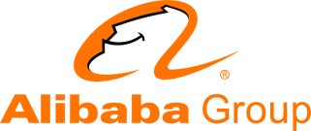
Alibaba
Group Structure
Alibaba Group Holdings Limited (Cayman Islands)
100%
100%
100%
100%
100%
100%
Taobao Holding Limited (Cayman Islands)
Alibaba.com Limited (Cayman Islands)
100%
Other subsidiaries
Alibaba Investment Limited (BVI)
Taobao China Holding Limited (Hong Kong)
Alibaba.com Investment Holding Limited (BVI)
100%
Outside China
Inside China
Wholly foreign owned enterprises
Taobao (China) Software Co., Ltd
Zhejiang Tmall Technology Co., Ltd
Hangzhou Alimama Technology Co., Ltd
Alibaba.com (China) Technology Co., Ltd.
Zhejiang Alibaba Cloud Computing Ltd.
Variable interest entity equity holders
Jack Ma
Simon Xie
Variable interest entities
Zhejiang Taobao Network Co., Ltd.
Zhejiang Tmall Network Co., Ltd.
Hangzhou Ali Technology Co., Ltd.
Hangzhou Alibaba Advertising Co., Ltd.
Alibaba Cloud Computing Ltd.
Equity interest
Contractual agreements
Source: Public information

